Slide 1

Bank Customer Churn Analysis

Slide 2
Team Members:
Dileep Kumar Seepani
Sai Siva Kishore Garapati
Ramesh Babu Pothula

Slide 3
Preface:
INTRODUCTION
ABOUT DATASET
OBJECTIVE
TOOLS USED
ANALYSIS ON BANK CUSTOMER CHURN
KEY FINDINGS & INSIGHTS
RECOMMENDATIONS
EXPERIENCE OF WORKING
CONCLUSION

Slide 4
Introduction:
Project: Bank Customer Churn Analysis
This project is developed using Power BI as the primary tool for data visualization and dashboard creation. The analysis is performed on a dataset containing 10,000 customer records sourced from a European bank operating across the countries like France, Germany, and Spain. The dataset includes key customer attributes such as age, gender, account balance, number of products held, credit score, tenure, activity status, and exit status.

Slide 5
About Dataset:
The Bank Customer Churn dataset consists of 7 tables and 14 columns, providing a comprehensive view of customer demographics, financial behavior, account activity, and exit patterns across a European bank. The dataset contains 10,000 customer records spanning three countries like France, Germany, and Spain and captures key attributes such as customer age, gender, credit score, account balance, number of products held, tenure with the bank, credit card ownership, activity status, and churn status. These attributes together form the foundation for identifying churn patterns, segmenting customers by risk level, and building an interactive Power BI dashboard to support data-driven retention strategies.
Tables included in the dataset:
Consumption → Energy usage by country, year, and energy type
Production → Energy production by country, year, and source
Emission_3 → Carbon emissions and per capita emissions
GDP_3 → Country-wise GDP values over the years
Population → Population values for each country and year
Country → Countries and Country codes

Slide 6
Objectives:
The objective of this project is to analyze global energy consumption, production, emissions, GDP, and population data to identify meaningful trends, country-wise patterns, and relationships between energy usage, economic growth, and environmental impact.
This project aims to use SQL to answer real-world analytical questions such as:
how energy consumption varies across countries,
how emissions are affected by population and economic growth,
which countries contribute most to global emissions,
and how energy-related indicators change over time.
The project also helps in strengthening practical SQL skills such as joins, aggregations, subqueries, Common Table Expressions (CTEs), and window functions, which are commonly used in Data Analyst roles.

Slide 7
Tools Used:
MySQL – For data analysis and query execution
MySQL Workbench – For writing and running SQL queries
SQL – For joins, aggregations, subqueries, CTEs, and window functions
Excel / CSV – For dataset storage and import
Relational Database Concepts – For handling structured multi-table analysis

Slide 8
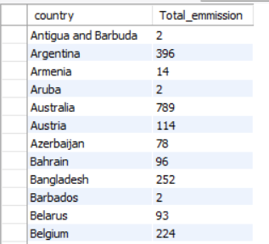
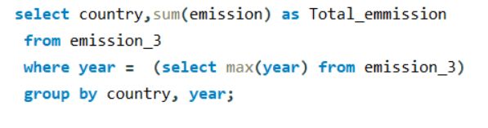
General & Comparative Analysis
What is the total emission per country for the most recent year available?
Observation:
The query shows the total emissions generated by each country in the most recent year available in the dataset.
The results indicate that emission levels vary significantly across countries, with some nations contributing much more than others.

Slide 9
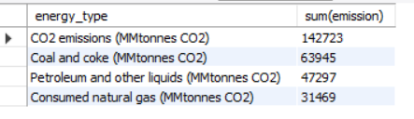

Which energy types contribute most to emissions across all countries?
Observation:
The results show that CO₂ emissions are the highest overall, followed by coal and coke, petroleum, and natural gas.
This indicates that fossil fuels, especially coal and petroleum, are major contributors to total emissions.

Slide 10
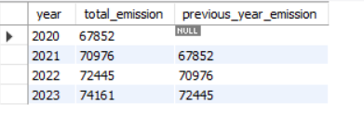
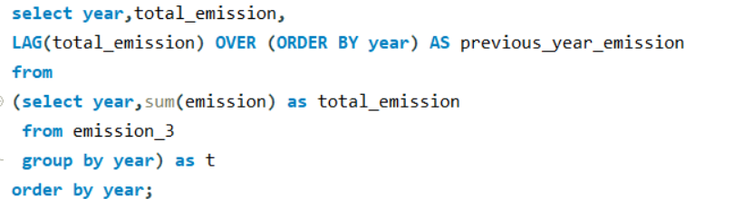
Trend Analysis Overtime
How have global emissions changed year over year?
Observation:
Global emissions increased from 67,852 in 2020 to 74,161 in 2023, showing an overall upward trend across the years.
Global emissions increased from 67,852 in 2020 to 74,161 in 2023, showing an overall upward trend across the years.

Slide 11
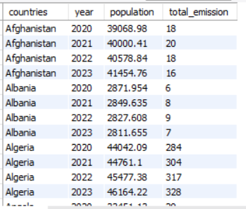
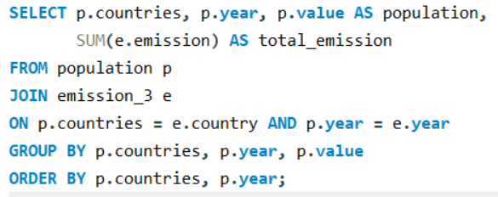
How has population growth affected total emissions in each country?
Observation:
The results show country-wise population and total emissions over the years, making it easier to compare how emissions change alongside population growth.
In some countries, emissions rise as population increases, while in others the trend is less direct, suggesting that additional factors also influence emissions.

Slide 12
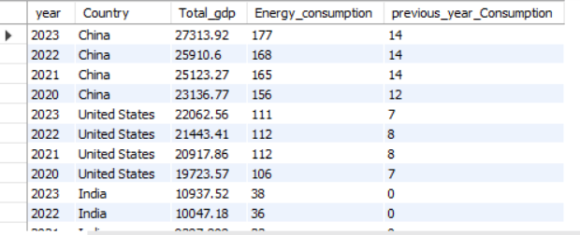
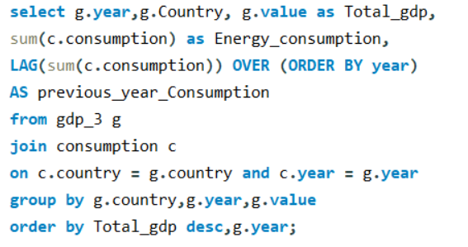
Has energy consumption increased or decreased over the years for major economies?
Observation:
The results compare GDP and energy consumption by country and year, while also showing the previous year’s consumption to identify consumption trends over time.
Major economies such as China and the United States consistently show high energy consumption, indicating a strong relationship between economic size and energy demand.

Slide 13
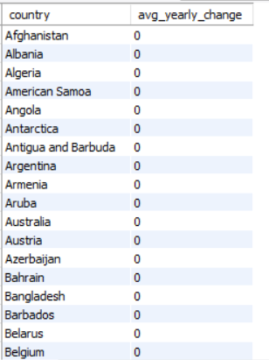
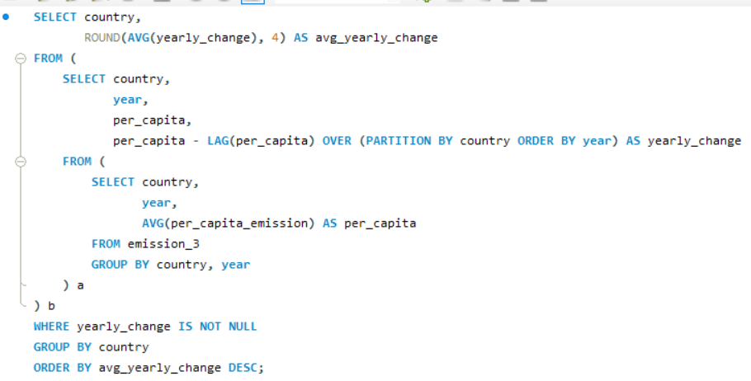
Ratio & Per Capita Analysis
What is the emission-to-GDP ratio for each country by year?
Observation:
The results show that the average yearly change in per capita emissions is 0 for all countries, indicating no variation across the available years in the dataset.
This suggests that the per_capita_emission column may contain repeated or constant values, making it unsuitable for meaningful trend analysis.

Slide 14
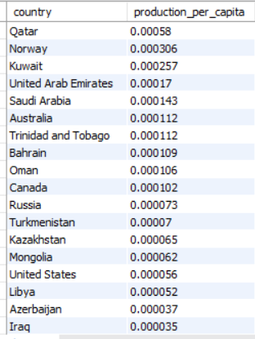
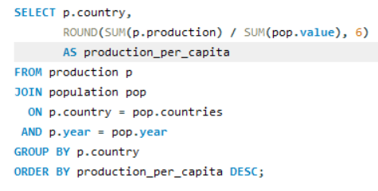
How does energy production per capita vary across countries?
Observation:
Countries like Qatar, Norway, and Kuwait have the highest energy production per capita, indicating strong energy output relative to their population size.
This suggests that resource-rich countries with smaller populations tend to have higher per capita production compared to larger or less resource-dependent nations.

Slide 15
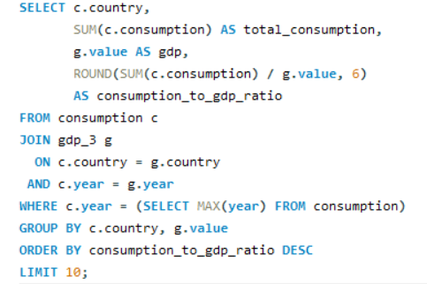
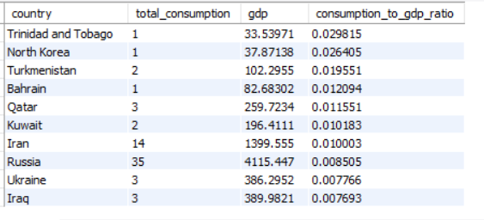
Which countries have the highest energy consumption relative to GDP?
Observation:
Countries such as Trinidad and Tobago, North Korea, and Turkmenistan show the highest energy consumption relative to GDP, indicating higher energy use compared to their economic output.
This suggests that these economies may be more energy-intensive or less energy-efficient than countries with lower consumption-to-GDP ratios.

Slide 16
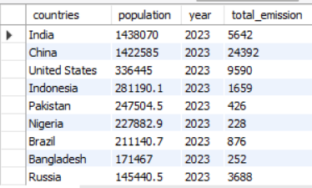
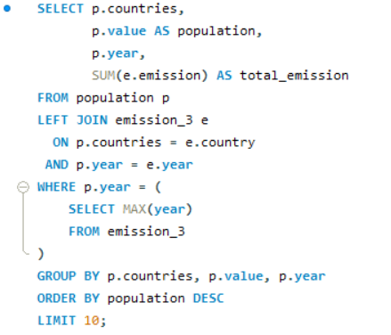
Global Comparisons
What are the top 10 countries by population and how do their emissions compare?
Observation:
The results show that highly populated countries like China, India, and the United States also have high total emissions, indicating a strong link between population size and emissions.
However, some countries with large populations have relatively lower emissions, suggesting that economic activity and energy usage patterns also play a significant role.

Slide 17
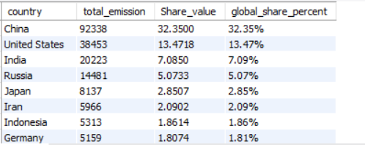
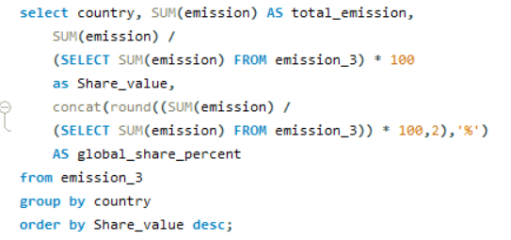
What is the global share (%) of emissions by country?
Observation:
China contributes the largest share of global emissions (~32%), followed by the United States and India, indicating a high concentration of emissions among a few major economies.
This shows that a small number of countries account for a significant portion of global emissions, highlighting their critical role in climate impact and policy decisions.

Slide 18
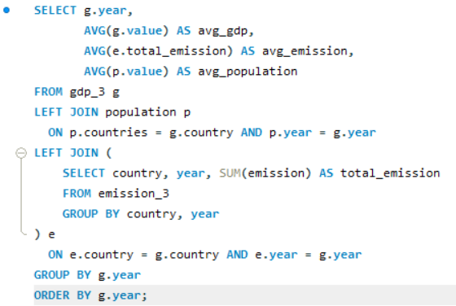
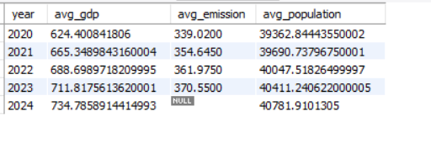
What is the global average GDP, emission, and population by year?
Observation:
The global averages of GDP, emissions, and population show a steady upward trend from 2020 to 2023, indicating overall growth across economic and demographic indicators.
In 2024, GDP and population continue to rise, but average emissions are NULL, suggesting that emission data is unavailable for that year.

Slide 19
Conclusion:
This project provided valuable insights into global energy consumption, production, emissions, GDP, and population trends across countries and years. The analysis revealed that energy usage and emissions are highly concentrated in major economies, and there is a strong relationship between economic growth and energy demand.
The project also highlighted that per capita metrics and efficiency ratios are important for meaningful comparisons, as countries with large populations do not always have the highest per capita impact. Additionally, some limitations in the dataset, such as constant per capita emission values and missing data for certain years, emphasized the importance of data quality in analysis.
Overall, this project helped in strengthening practical SQL skills, including joins, aggregations, subqueries, and window functions, while also demonstrating how data can be used to derive real-world insights about energy usage, sustainability, and economic patterns.

Slide 20
Experiences & Challenges:
Worked with a multi-table real-world dataset containing energy consumption, production, emissions, GDP, and population data, which improved my understanding of relational databases and analytical thinking.
Gained practical experience in using SQL concepts such as joins, aggregations, subqueries, and window functions to answer business-oriented questions and generate meaningful insights.
Faced challenges in identifying the correct grouping level, join conditions, and calculation logic, especially while working with per capita metrics, trend analysis, and country-year comparisons.
Encountered data quality issues such as missing values, repeated per capita emission values, and inconsistent year availability, which helped me understand the importance of data validation and debugging in real-world analysis.

Slide 21

THANK YOU

